Slide 1



Management of the Great Barrier Reef: A success?
R. Kelley
Jon Brodie
Catchment to Reef Research Group, TropWATER, James Cook University, Townsville, Australia.
Brodie, J. and Waterhouse, J. 2012. A critical review of the environmental management of the ‘not so Great’ Barrier Reef. Estuarine, Coastal and Shelf Science 104-105, 1-22.
catchment to reef

Slide 2
Answer
NO

Slide 3
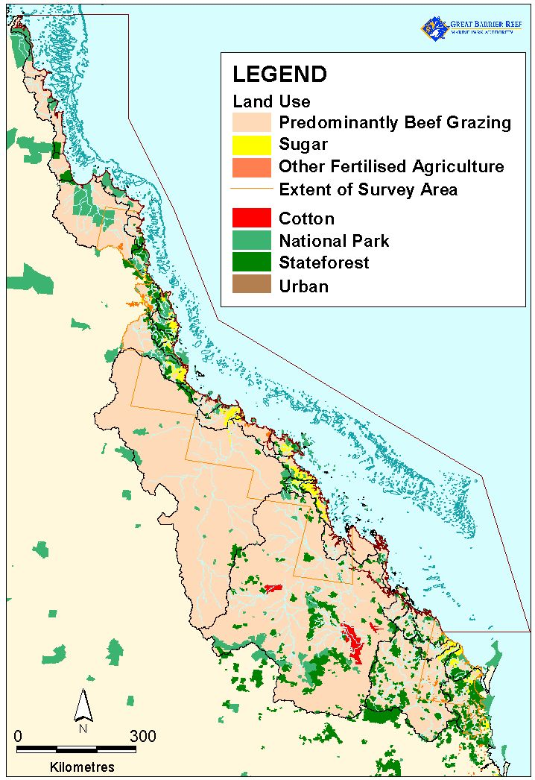
Great Barrier Reef WHA, Marine Park and
Catchment Area

Slide 4
Status of the GBR
(from Brodie and Waterhouse 2012)
Coral cover from about 40% fifty years ago to less than 20% currently and predicted to decline further (Hughes et al. 2011; De’ath et al. in review)
Dugong populations continue to decline
Seagrass in trouble especially associated with both chronic stress and extreme events (Devlin et al. 2012).
Shark populations declining (Robins et al. 2006)
Crown of thorns starfish outbreaks started again for the 4th ‘wave’ (Fabricius et al. in prep.)
Increasing incidence of coral diseases
Increasing water temperatures
Declining calcification (e.g. Cooper et al. )

Slide 5
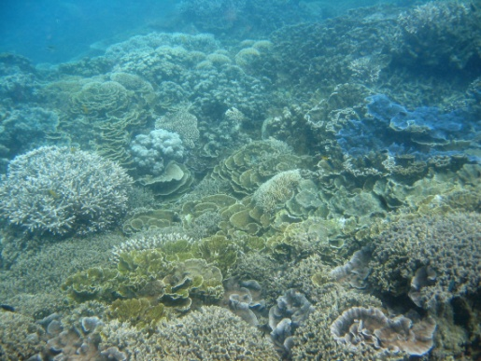
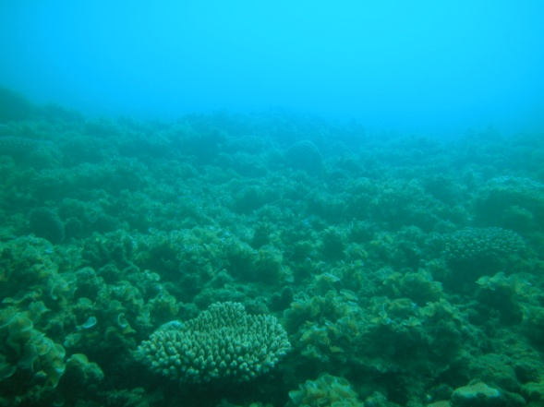
Coral cover decline
Coral cover in ~1960 = 40 – 55% (Bruno and Selig 2007; Bellwood et al. 2004; Hughes et al. 2011)
Coral cover in 1986 = 28% (Sweatman et al. 2011)
Coral cover in 2004 = 22% (Sweatman et al. 2011)
Coral cover in 2012 = <20% (De’ath et al. in review)
Coral cover in 2020?

Slide 6
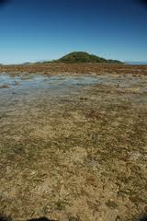
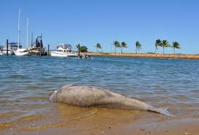
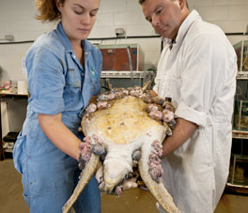
Seagrass and dugong (and turtle?) decline

Slide 7
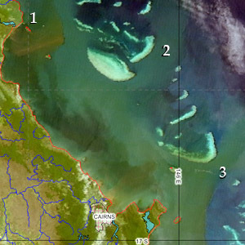
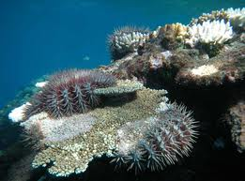
Crown of thorns starfish again
Three waves of outbreaks 1962 – 1975; 1978 – 1990; 1993 – 2005
Now well understood to be linked to increased nutrient discharge from the land (Brodie et al. 2005; Fabricius et al. 2010)
Removal of fish predators may also be linked. No-take zones have less COTs. (Sweatman et al 2009)
Largest cause of coral mortality on the GBR (Osborn et al. 2011; Hughes et al. 2011)
Fourth wave of outbreaks now likely to be starting off Cairns region (where all the other waves began) (Fabricius et al. in prep.)
We can now expect high coral mortality from COTS in the central GBR over the next 10 years.

Slide 8
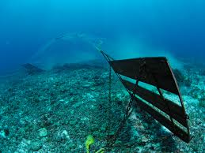
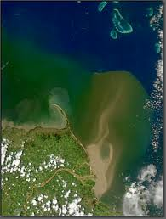
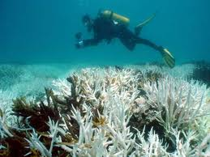
What are the proven issues?
Fishing
http://marksecology.blogspot.com/2011/04/big-fish-review-part-2.html
Terrestrial pollutant runoff
Climate change
Bainbridge et al. 2012
Climateshifts

Slide 9
History of management
Marine Park Act – 1975
Great Barrier Reef Marine Park Authority – established 1975
AIMS established – 1972
Zoning complete by about 1990
Plans of management
Pesticide management through APVMA
However management over the first 20 years focussed largely on tourism and exclusion of fishing only in the small area of no-take zones. Traditional fisheries management prevailed as well by the Qld. Gov.

Slide 10
What about management of fishing, water quality and climate change?
More intensive fishing management with trawl management planning in about 2000 and the rezoning of 2004
Reef Plan first implemented through the Australian Government’s Reef Rescue starting in 2008 and the Queensland Government’s Reef Protection Package in 2009/10 (Brodie et al. 2011,2012)
Climate change management ??
Pesticide management through APVMA ineffective (King et al. 2012)

Slide 11
Status of GBRWHA and water quality
Scientific consensus statement on water quality in the Great Barrier Reef (Brodie et al 2008)
Water discharged from rivers to the GBR continues to be of poor quality in many locations.
Land derived contaminants, including suspended sediments, nutrients and pesticides are present in the GBR at concentrations likely to cause environmental harm.
There is strengthened evidence of the causal relationship between water quality and coastal and marine ecosystem health.
The health of freshwater ecosystems is impaired by agricultural land use, hydrological change, riparian degradation and weed infestation
Current management interventions are not effectively solving the problem.
Climate change and major land use change will have confounding influences on GBR health.
Effective science coordination to collate, synthesise and integrate disparate knowledge across disciplines is urgently needed.
A revised and updated Consensus Statement is in preparation over the next 6 months.

Slide 12
Water quality management response
Research program 1980 – 1990 (moderate funding & effort) and 1990 – 2000 (high funding & effort)
First consensus statement – Williams et al. 2001
Water Quality Action Plan (Brodie et al 2001) – follows decades of research and monitoring
Sewage discharges relatively effectively managed (at least in terms of nutrients) in the 1990s.
Reef Water Quality Protection Plan (RWQPP) 2003: Joint Australian and Queensland State governments plan.
“halt and reverse the decline in water quality entering the Reef within ten years”
Regional water quality improvement plans (2005 – 2008)
ReefPlan 2009: Updated version of RWQPP with more definite targets and actions
Reef Rescue (2008): Australian Government voluntary incentive based program ($200M) over 5 years for on-ground works, monitoring, research and partnerships
Great Barrier Reef Protection Amendment Act 2009: Queensland Government regulatory regime to improve water quality for the GBR
So ~30 years to get from beginning of research and monitoring to effective management!

Slide 13
WQ issues in the coastal areas often outside the GBRMP
Different pollutants – toxic metals (from ports, coastal industry), Endocrine Disrupting Chemicals (e.g.pesticides - atrazine, sewage effluent, - various organic chemicals), pharmaceuticals, petroleum hydrocarbons, coal dust, anti-foulants (e.g. TBT- Hay Point case), nanoparticles
Different industries/landuses (besides agriculture) – ports shipping, urban, heavy industry, fish cage culture.
Poorly flushed waters (estuaries, bays, ‘narrows’), pollutant entry often in low river flow conditions
Adjacent freshwater systems (rivers, wetlands) also under threat from multiple water quality impacts (and other impacts) and vitally connected to the GBRWHA but little concern or management response.

Slide 14
Management of the ‘outside the MP’ WHA
Need for an integrated management regime for this area as for the GBRMP.
However some sections may have to be ‘sacrificed’ for development but these areas need to be centralised into a few hubs and then still managed as well as possible.

Slide 15
Why has management failed
Early emphasis on tourism management – which was not the main issue.
Fishing only comprehensively managed by 2005
Terrestrial runoff only managed by 2009
Pesticide management still an issue due to ineffectiveness of APVMA
Climate change not managed at all
Coastal development poorly managed and in contrast to other issues management seems to be getting worse e.g. Gladstone Port
Difficulties of getting scientific consensus, political agreement , organizational structure and a funded management response.

Slide 16
Conclusions – prognosis for the GBR
Poor in the face of further COTs, bleaching, increased extreme weather, increasing coastal development
Hence the need to continue the things we can do – terrestrial runoff management; enforcing the zoning; better coastal management – improved resilience
GBRWHA managed as a unit and not in several parts as happens now. Need for ecosystem based management.

